Slide 1
SCIENCE SUBJECT FOR ELEMENTARY:
1st Grade
Here is where your presentation begins

Slide 2
CONTENTS OF THIS TEMPLATE
Here’s what you’ll find in this Slidesgo template:
A slide structure based on a presentation for education, which you can easily adapt to your needs. For more info on how to edit the template, please visit Slidesgo School or read our FAQs.
An assortment of graphic resources that are suitable for use in the presentation can be found in the alternative resources slide.
A thanks slide, which you must keep so that proper credits for our design are given.
A resources slide, where you’ll find links to all the elements used in the template.
Instructions for use.
Final slides with:
The fonts and colors used in the template.
A selection of illustrations. You can also customize and animate them as you wish with the online editor. Visit Storyset to find more.
More infographic resources, whose size and color can be edited.
Sets of customizable icons of the following themes: general, business, avatar, creative process, education, help & support, medical, nature, performing arts, SEO & marketing, and teamwork.
You can delete this slide when you’re done editing the presentation.

Slide 3
TABLE OF CONTENTS
01
02
INTRODUCTION
TOOLS
03
04
ACTIVITIES
CONCLUSION
You can describe the topic of the section here
You can describe the topic of the section here
You can describe the topic of the section here
You can describe the topic of the section here

Slide 4
WHOA!
This can be the part of the presentation where you introduce yourself, write your email…

Slide 5
INTRODUCTION
You can give a brief description of the topic you want to talk about here. For example, if you want to talk about Mercury, you could say that it’s the smallest planet in the entire Solar System

Slide 6
— SOMEONE FAMOUS
“This is a quote, words full of wisdom that someone important said and can make the reader get inspired”

Slide 7
01
INTRODUCTION
You can enter a subtitle here if you need it

Slide 8
STEPS TO LEARN TO INQUIRY
Learning to inquiry can be very easy. Do you know how?
The provocations generate enthusiasm in the students motivating them to think about what is next
Observation helps us collect data to propose theories
Asking questions is very important when doing inquiry
Use the right tools to conduct the inquiry

Slide 9
TIPS FOR A GOOD INQUIRY
CURIOSITY
THEORIES
RECORD IT
TOOLS
Jupiter is the biggest planet
Venus has a very beautiful name
Despite being red, Mars is very cold
Saturn is composed of hydrogen

Slide 10
A PICTURE ALWAYS REINFORCES THE CONCEPT
Images reveal large amounts of data, so remember: use an image instead of a long text. Your audience will appreciate it

Slide 11
USE THE TOOLS
LENSES
RECORD
MEASURING
Venus has extremely high temperatures
Mercury is the smallest planet of them all
Despite being red, Mars is a very cold

Slide 12
WHICH IS WHICH?
hand lens
goggles
flask
thermometer
clipboard
beaker

Slide 13
WHICH IS WHICH?
hand lens
goggles
flask
thermometer
clipboard
beaker

Slide 14
MATCH THE WORD AND THE MEANING...
D
T
M
H
C
F
magnet • thermometer • droppet
clock • flask hand • lens
A tool for
measuring liquids
A tool for temperatures
A tool used to pick up magnetic objects
A tool to magnify small objects
A tool used to keep track of time
A tool used to hold and heat liquids

Slide 15
333,000
24h 34m 23s
386,000 km
Earths is the Sun’s mass
is Jupiter’s rotation period
distance between the Earth and the Moon

Slide 16
VOCABULARY CUT AND PASTE
clock
droppet
magnet
clipboard
I used a |  | to take notes
I used a |  | to pick up the clip
I used a |  | to keep track of time
I used a |  | to measure liquids by drops

Slide 17
02
TOOLS
You can enter a subtitle here if you need it

Slide 18
RECORD THE TEMPERATURE
0ºC
22ºC
100ºC
Water begins to freeze
Room temperature
Water starts boiling

Slide 19
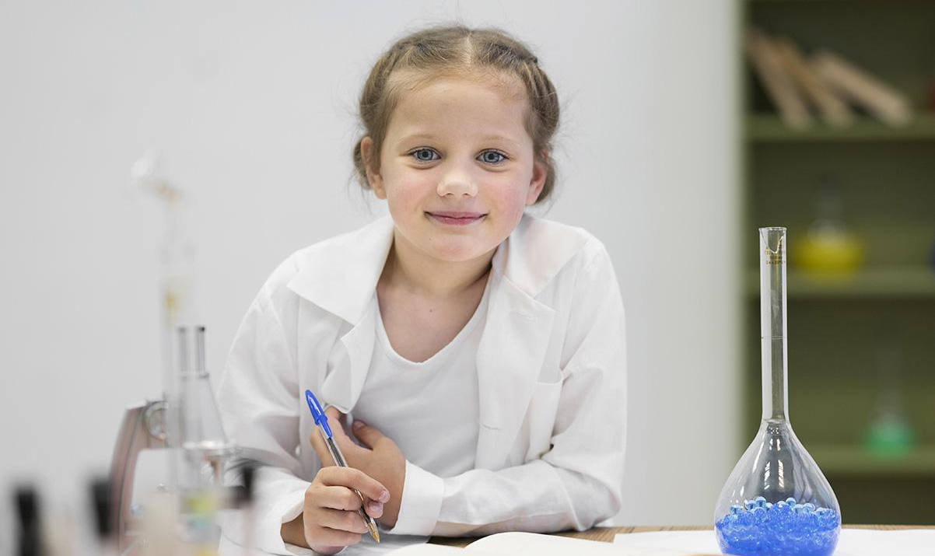
WATCH THE VIDEO
Despite being red, Mars is a cold place, not hot. It’s full of iron oxide dust, which gives the planet its reddish cast
Insert your multimedia content here

Slide 20
UNITS OF TEMPERATURE
120
50
100
40
FAHRENHEIT
30
CELSIUS
80
Mercury is the closest planet to the Sun and the smallest one
20
Venus has a beautiful name, but its atmosphere is poisonous
60
10
40
0
(ºF)
20
(ºC)
-10
0
-20
-20
-30
-40
-40

Slide 21
THERMOMETER TIMELINE
-20º C
0º C
22º C
40º C
It’s very cold temperature
Water begins to freeze
It’s room temperature
High fever temperature

Slide 22
INQUIRY PROCESS
PREDICT
Ceres is located in the main asteroid belt
DISCOVER
The Sun is the star at the center of the System
INQUIRY
QUESTION
Neptune is the farthest planet from the Sun
SOLVE
Saturn is composed of hydrogen and helium

Slide 23
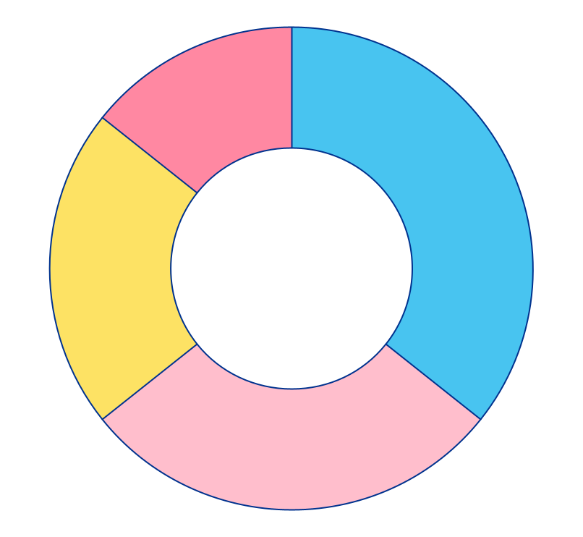
USE OF TOOLS IN INQUIRE SCIENCE
SAFETY
14%
35%
MEASURE
Jupiter is the biggest planet of them all
Despite being red, Mars is a cold place
ANALYZE
22%
29%
OBSERVATION
Venus has very high temperatures
Saturn is composed of hydrogen
Follow the link in the graph to modify its data and then paste the new one here. For more info, click here

Slide 24
INQUIRY IN THE WORLD
JUPITER
It’s the biggest planet in the System
MERCURY
It’s the second planet from the Sun

Slide 25
CHARACTERISTIC OF TOOLS
Put in the box the correct tool to use in science
TOOL PURPOSE | TOOL | TOOL
TO OBSERVE
TO MEASURE VOLUME
TO MEASURE TEMPERATURE

Slide 26
MICROSCOPE PARTS
LENS
ARM
Jupiter is the biggest planet
Despite being red, Mars is a cold place
STAGE
BASE
Venus is the second planet from the Sun
Saturn is composed of hydrogen

Slide 27
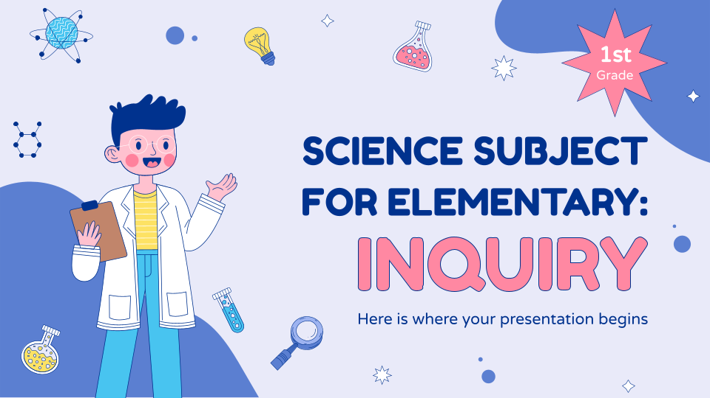
DESKTOP SOFTWARE
You can replace the image on the screen with your own work. Just right-click on it and select “Replace image”

Slide 28

TABLET APP
You can replace the image on the screen with your own work. Just right-click on it and select “Replace image”

Slide 29
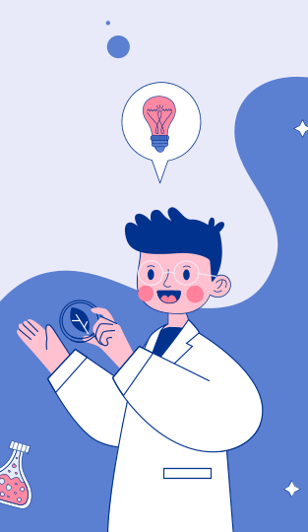
MOBILE WEB
You can replace the image on the screen with your own work. Just right-click on it and select “Replace image”

Slide 30
MY EXPERIMENT
Does water have the same shape if the temperature is different?
My hypothesis: Yes or No
Cold
Warm
Hot
My conclusion:

Slide 31
THANK YOU!
Do you have any questions?
youremail@freepik.com
+91 620 421 838
yourcompany.com
Please keep this slide for attribution

